Slide 1
SKYCANVAS AN INVISIBLE AIR CANVAS
An AI project based on OpenCV and Gesture Recognision

Slide 2

OUR TEAM
Sushant Patil 22220038
Khushi Asodekar 22220115
Yash Anbhore 22220142
Shruti Ghodake 22220212

Slide 3
TABLE OF CONTENT
01
06
02
03
04
05
Actual problem
Objectives
Introduction
07
Future scope
Motivation
08
Requirements
Literature Survey
09
Social Impact
Gap analysis
10
Conclusion

Slide 4
01
THE ACTUAL PROBLEM

Slide 5
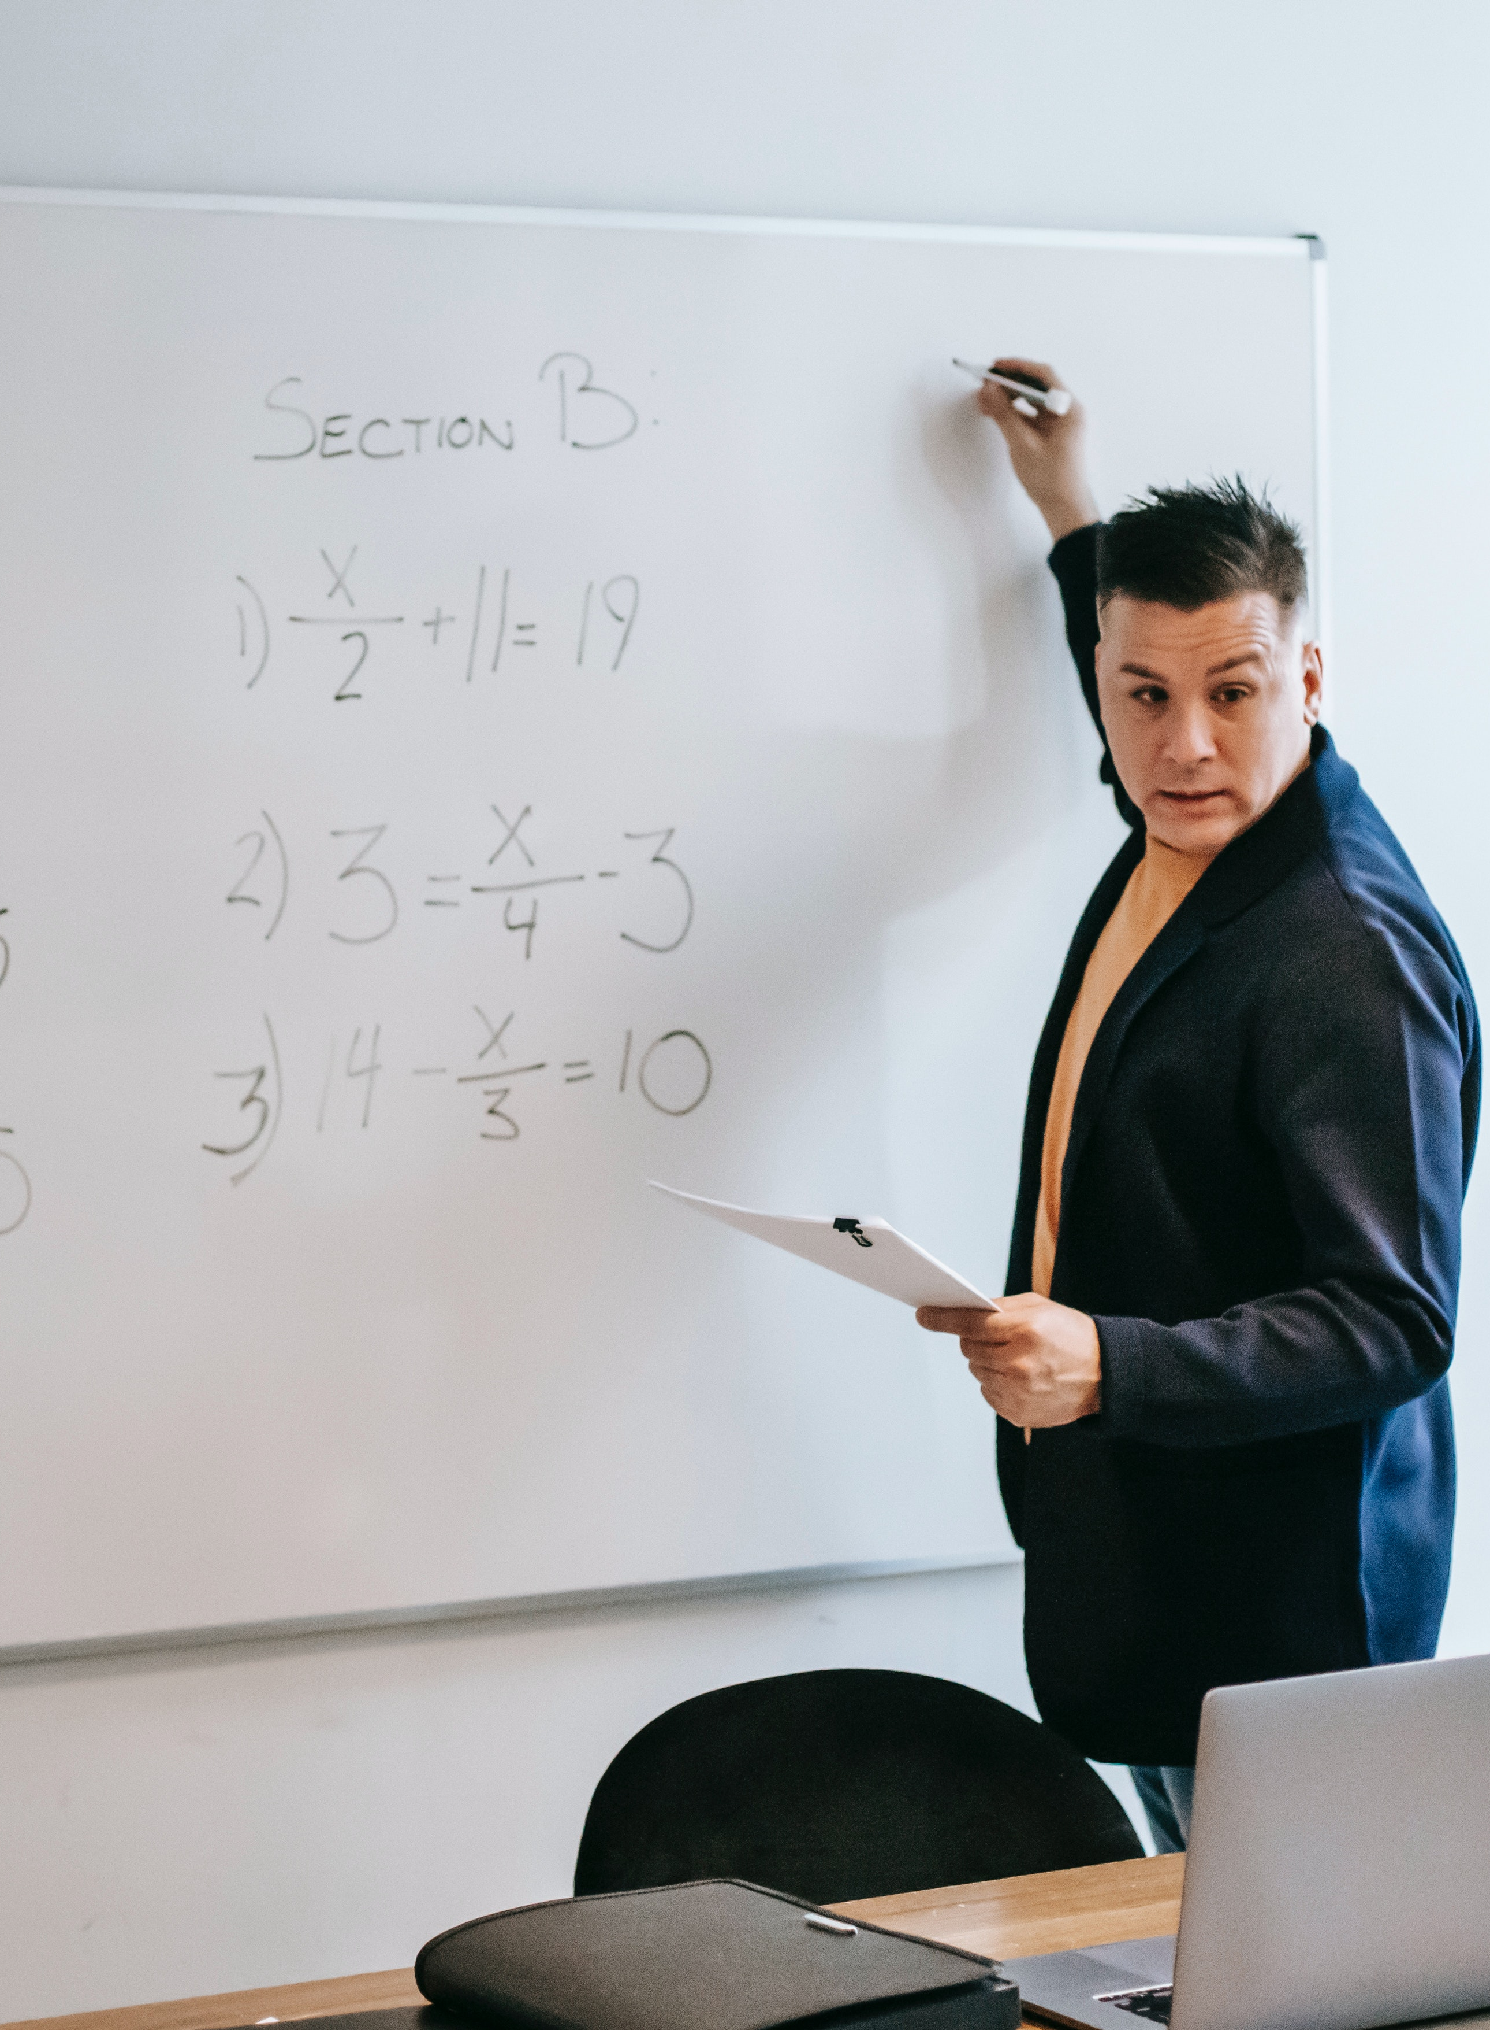
ACTUAL PROBLEM
Traditional teaching tools (e.g., physical and digital boards) are costly to acquire and maintain.
These tools require dedicated physical space, making them impractical for some settings.
Accessibility to such tools is limited, creating inequalities in education.
The rigidity of existing tools can hinder educators in effectively teaching complex concepts.

Slide 6
02
INTRODUCTION

Slide 7
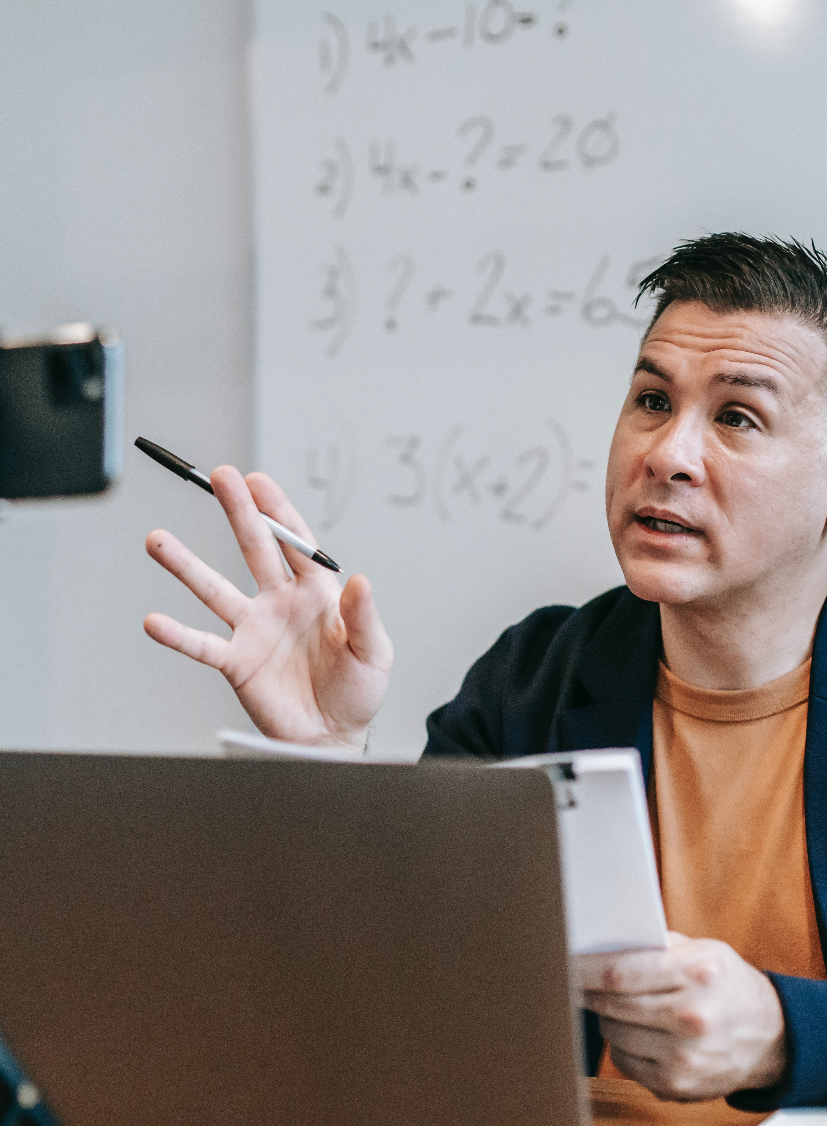
INTRODUCTION
Our project, the “Invisible Air Canvas," is an innovative solution to the problem mentioned above. It leverages computer vision and machine learning technologies to transform any space into a virtual canvas for teaching and learning. Using a simple setup that includes a camera and a computer, our system allows users to draw and write in the air, converting their gestures into digital images that can be projected onto a screen and can be helpful in recording video courses.

Slide 8
MOTIVATION
The motivation behind our project is to democratize education tools and make them accessible to everyone, regardless of their financial constraints or geographical location. We believe that technology should enhance, not hinder, the learning process. By providing an affordable and intuitive solution for teachers to create engaging presentations and explain concepts with ease, we aim to revolutionize the way education is delivered.

Slide 9
LITERATURE SURVEY
A Review of Detection and Tracking of Object from Image and Video Sequences | Review on different object detection, tracking, recognition techniques,feature descriptors and segmentation method which is based on the video frame and various tracking technologies.
AIR CANVAS APPLICATION USING OPENCV AND NUMPY IN PYTHON | Using a handwriting recognizer in place of a character recognizer will allow the user to write word by word, making writing faster. Secondly, hand-gestures with a pause can be used to control the real-time system
Air-Swipe Gesture Recognition Using OpenCV in Android Devices | The proposed approach is to recognize dynamic gestures on the resource limited gadgets like smartphone. The application of OpenCV for matrix allocation, with real-time computation is the key focus of this research effort
Real time Finger Tracking and Contour Detection for Gesture Recognition using OpenCV | The processing steps to classify a gesture included gesture acquisition, segmentation, filtering, contour representation and classification using different techniques.

Slide 10
LITERATURE SURVEY
Numerous studies have explored hand gesture recognition as a fundamental component of interactive systems. Works by C. Li et al. (2018) and T. K. Kim et al. (2017) have advanced the field, demonstrating the potential of convolutional neural networks (CNNs) and recurrent neural networks (RNNs) in accurately detecting and classifying hand gestures.
Hand Gesture Recognition
The real-time tracking of hand movements is crucial for seamless user experiences. Research by T. A. Y. H. C. Kim et al. (2020) on efficient hand tracking algorithms, such as MediaPipe.
Real-Time Tracking
In summary, while there exists prior high-quality research on Real-time Finger Tracking for Gesture Recognition utilizing OpenCV, there remains a noticeable gap in effectively integrating this technology into educational settings. Furthermore, these systems are not yet user-friendly enough to be accessible to individuals of all ages, so we are willing to make it as simple as even a 5-year-old child can use our software effortlessly!

Slide 11
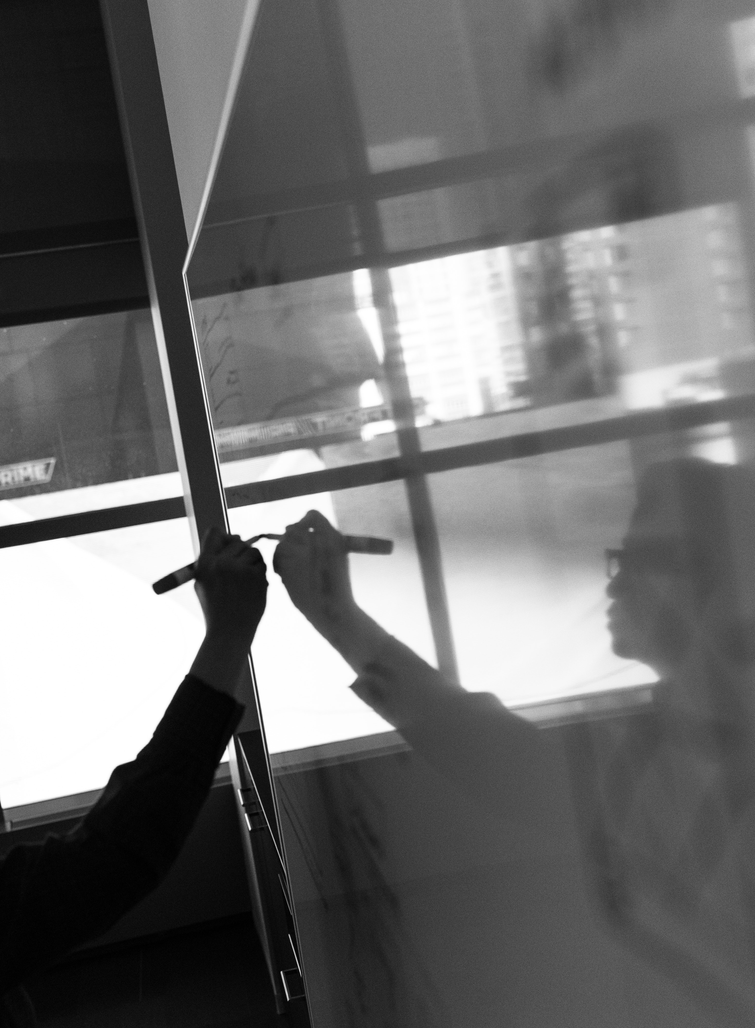
GAP ANALYSIS
Existing digital board solutions are expensive, require specific hardware, and are often limited to fixed locations. Moreover, they may not be readily available in every educational setting. This creates a gap in providing an interactive and dynamic learning experience to students. Our project aims to bridge this gap by offering a cost-effective, portable, and accessible alternative.

Slide 12
OBJECTIVES
Develop a real-time hand gesture recognition system for drawing and writing in the air.
Create an intuitive user interface for teachers to control and customize their runtime writings/drawing.
Implement machine learning algorithms to train the system to recognize gestures quickly and reliably.
Ensure real-time responsiveness to user gestures to provide a seamless drawing experience.
Ensure affordability and accessibility for educational institutions of all sizes.

Slide 13
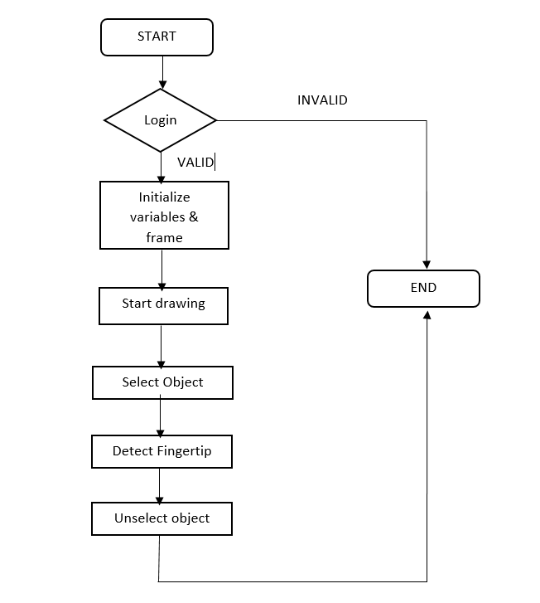
FLOWCHART

Slide 14
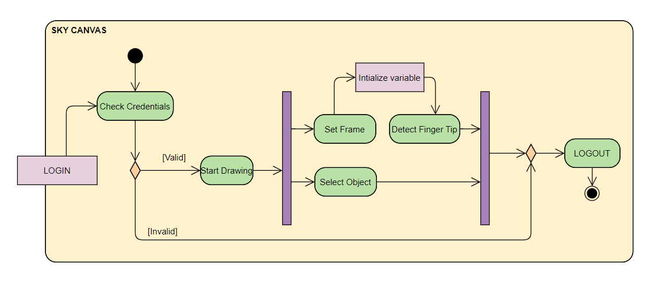
ACTIVITY DIAGRAM

Slide 15
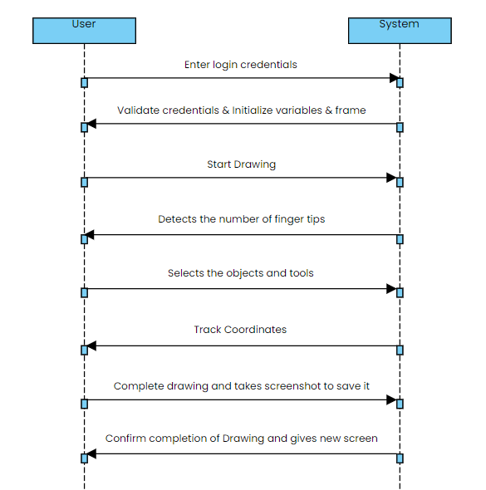
SEQUENCE DIAGRAM

Slide 16
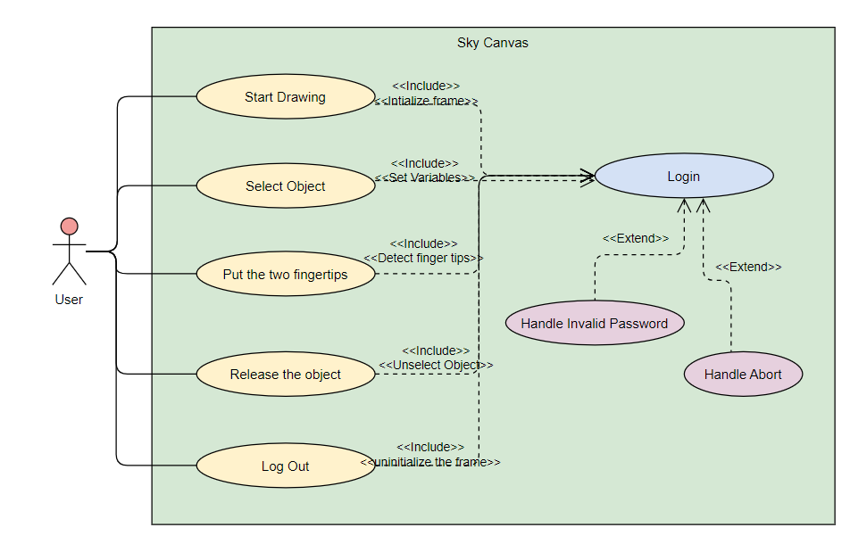
USE CASE DIAGRAM

Slide 17
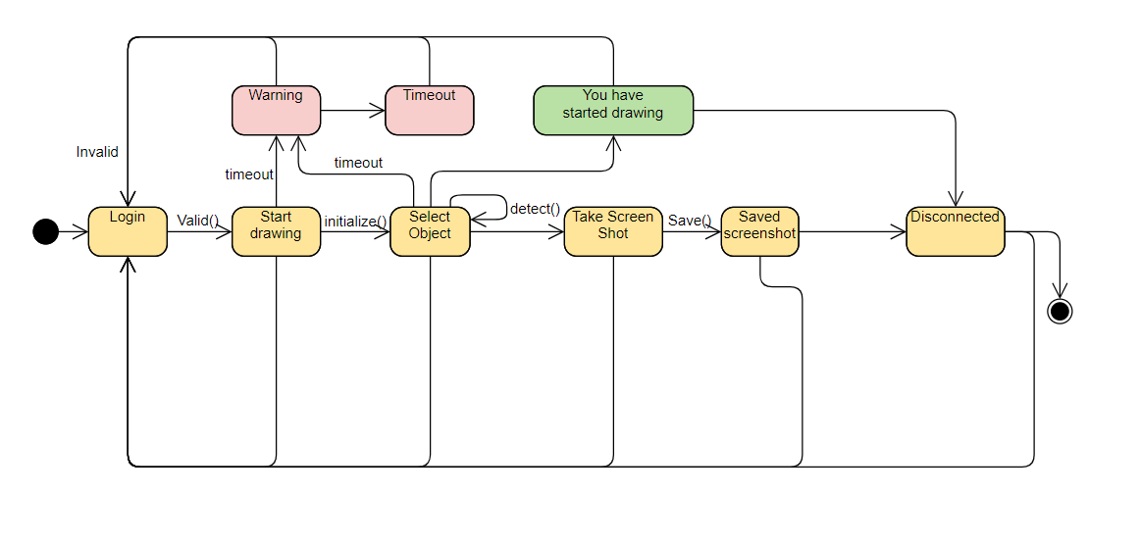
STATE MACHINE DIGRAM

Slide 18
FUTURE SCOPE
VR Integration
Invisible Navigator System
We can incorporate virtual reality to create a 3D educational environment, allowing users to draw and write in virtual space. This enhances immersion and is ideal for subjects requiring 3D understanding or virtual field trips.
SAVE IT
Enhance AIR Canvas to enable users to control laptops with hand gestures. Simplify tasks, boost productivity, and offer an engaging user experience, particularly in presentations and design work.
We can save all the drawings into the compatible formats so that users can head back into the past for their previous works

Slide 19
HARDWARE & SOFTWARE REQUIREMENTS
HARDWARE
SOFTWARE
A camera (webcam or smartphone camera) and a computer with reasonable processing power.
OpenCV for computer vision, machine learning libraries (e.g., TensorFlow or PyTorch),

Slide 20

SOCIAL IMPACT
The social impact of our project is significant. It:
Reduces the financial burden on educational institutions, making quality education more accessible.
Empowers teachers to create more engaging and interactive lessons.
Increases flexibility in teaching methods, benefiting students with diverse learning styles.
Promotes remote and online education, especially in times of crisis.

Slide 21
CONCLUSION
In conclusion, our “Invisible Air Canvas" project aims to revolutionize teaching and learning by providing an affordable, accessible, and interactive platform. By enabling teachers to draw and write in the air, we eliminate the need for expensive digital boards and make education more engaging. Our solution has the potential to reshape the way we teach and learn, making it accessible to everyone, anywhere, and at any time.

Slide 22
THANKS A LOT

